Slide 1

GFS, CDN & DNS
Computer System Engineering, Fall 2019. (IPADS, SJTU)
Naming in the Internet
Yubin Xia

Slide 2
GFS

Slide 3



How to Further Scale?

Slide 4
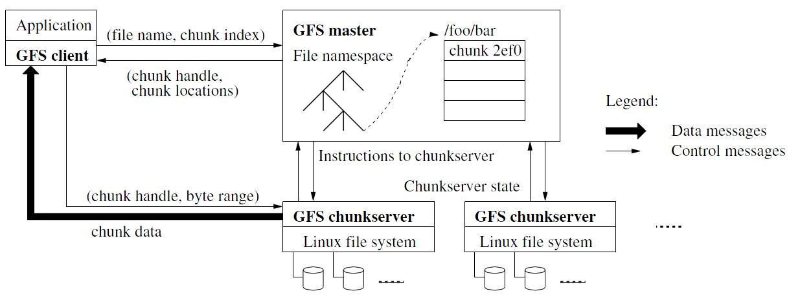
Architecture of GFS

Slide 5
GFS Cluster
Single master
Maintains file system metadata
Namespace
Access Control Information
Mapping from files to chunks
Current locations of chunks
Multiple chunkservers
Files of fixed sized chunks
Each chunk has a globally unique 64-bit chunk handle

Slide 6
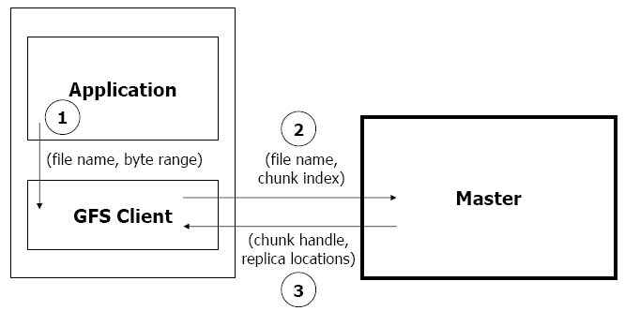
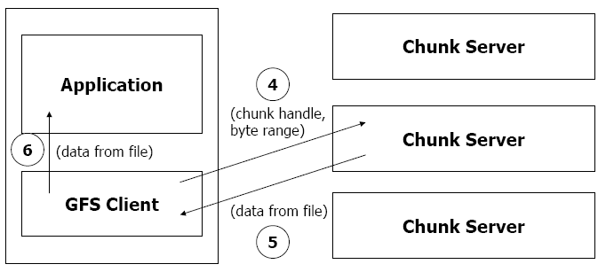
Read Algorithm

Slide 7
Read Algorithm
1. Application originates the read request.
2. GFS client translates the request from (filename, byte range) -> (filename, chunk index), and sends it to master.
3. Master responds with chunk handle and replica locations (i.e. chunk servers where the replicas are stored).
4. Client picks a location and sends the (chunk handle, byte range) request to that location.
5. Chunk server sends requested data to the client.
6. Client forwards the data to the application.

Slide 8
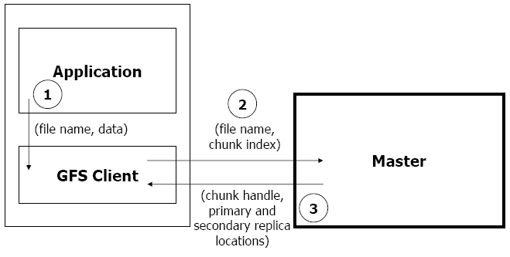
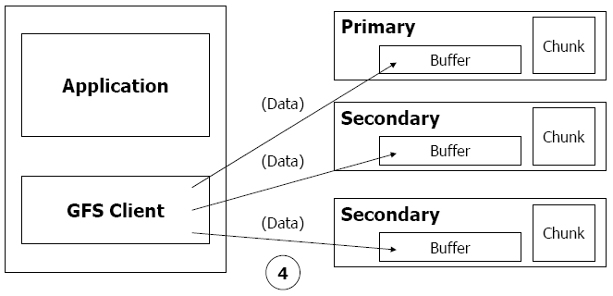
Write Algorithm

Slide 9
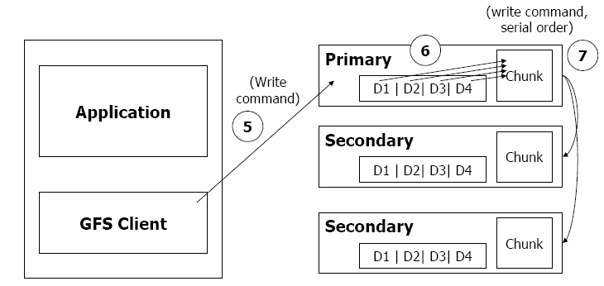
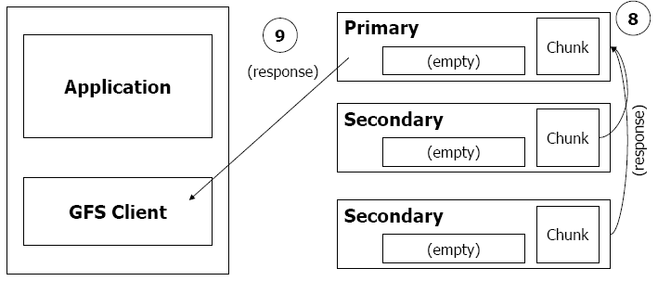
Write Algorithm

Slide 10
Write Algorithm
1. Application originates write request.
2. GFS client translates request from (filename, data) -> (filename, chunk index), and sends it to master.
3. Master responds with chunk handle and (primary + secondary) replica locations.
4. Client pushes write data to all locations. Data is stored in chunkservers' internal buffers.
5. Client sends write command to primary.

Slide 11
Write Algorithm
6. Primary determines serial order for data instances stored in its buffer and writes the instances in that order to the chunk.
7. Primary sends serial order to the secondaries and tells them to perform the write.
8. Secondaries respond to the primary.
9. Primary responds back to client.
Note: If write fails at one of chunk servers, client is informed and retries the write.

Slide 12
Design Architecture
Principle: data flow is decoupled from control flow
Clients interact with the master for metadata operations
Clients interact directly with chunkservers for all files operations
This means performance can be improved by scheduling expensive data flow based on the network topology
Neither the clients nor the chunkservers cache file data
Working sets are usually too large to be cached, chunkservers can use Linux's buffer cache

Slide 13
Single Master Node
Clients do not read or write through the master
The master relays relevant chunkserver location information to the client
The client temporarily caches the chunkserver data and directly accesses the chunkserver
Shadow Masters (for fault tolerance)

Slide 14
Metadata on Master
Metadata is stored in memory
Namespaces and file-to-chunk mappings are also stored persistently in operation log
Master monitors chunk location through heartbeat messages with each chunk
The namespace metadata
Master does not use any per-directory data structures
No inodes! No symlinks or hard links, either
Every file and directory is represented as a node in a lookup table, mapping pathnames to metadata
Stored efficiently using prefix compression
< 64 bytes per namespace entry

Slide 15
Chunkserver
Contains chunks (blocks, each 64MB) of a fixed size
Fewer chunk location, fewer metadata (all in memory)
Chunks are replicated regularly
Default: 3-way mirror (across machines and racks)
Talks with master through heartbeat messages
Master determines chunk locations and assesses state of the overall system
Note: The chunkserver has the final word over what chunks it does or does not have on its own disks – not the master

Slide 16
Why a Single Master?
The master now has global knowledge of the whole system, which drastically simplifies the design
But the master is (hopefully) never the bottleneck
Clients never read and write file data through the master; client only requests from master which chunkservers to talk to
Master can also provide additional information about subsequent chunks to further reduce latency
Further reads of the same chunk don't involve the master, either

Slide 17
Why a Single Master?
Master state is also replicated for reliability on multiple machines, using the operation log and checkpoints
If master fails, GFS can start a new master process at any of these replicas and modify DNS alias accordingly
"Shadow" masters also provide read-only access to the file system, even when primary master is down
They read a replica of the operation log and apply the same sequence of changes
Not mirrors of master: they lag primary master by fractions of a second
This means we can still read up-to-date file contents while master is in recovery!

Slide 18
Fault Tolerance and Diagnosis
Fast recovery
Master and chunkserver are designed to restore their states and start in seconds
Chunk replication : 3-way mirrors
Across multiple machines, across multiple racks

Slide 19
Fault Tolerance and Diagnosis
Master Mechanisms
Log of all changes made to metadata
Periodic checkpoints of the log
Log and checkpoints replicated on multiple machines
Master state is replicated on multiple machines
"Shadow" masters for reading data if "real" master is down

Slide 20
Fault Tolerance and Diagnosis
Data integrity
A chunk is divided into 64-KB blocks
Each with its 32-bit checksum
Verified at read and write times
Also scans for rarely used data in background

Slide 21

Typical Workloads on GFS
Two kinds of reads: large streaming reads & small random reads
Large streaming reads usually read 1MB or more
Oftentimes, applications read through contiguous regions in the file
Small random reads are usually only a few KBs at some arbitrary offset
Also many large, sequential writes that append data to files
Similar operation sizes to reads
Once written, files are seldom modified again
Small writes at arbitrary offsets do not have to be efficient
Multiple clients (e.g. ~100) concurrently appending to a single file
e.g. producer-consumer queues, many-way merging

Slide 22
Summary of GFS
Runs on commodity hardware and is scalable
Performs well for the specified tasks and assumptions previously mentioned
Innovation
File system API tailored to stylized workload
Single-master design to simplify coordination
Metadata fit in memory

Slide 23
Summary of GFS
Flat namespace
Dedicated Care for Component Failure
hard disk failure, data corruption, network disconnection, etc.
High-throughput
Minimized the master involvement
Chunk servers themselves send and receive the client data
The master leases authority to mutate chunks

Slide 24
Content Distribution
Files on the Internet

Slide 25
Content Distribution
How to reduce load latency over Internet?
Large files, e.g., images and videos
Client side
Many people from SJTU might access same web pages
Save bandwidth by caching a local copy
Server side
Not all clients use cache
Push data out to content distribution network (CDN)

Slide 26
Caching Examples
Web browser caches recently accessed files
E.g., allow "back" button to operate more efficiently
Web proxies cache recently accessed URLs
Save bandwidth/time when multiple people locally access same remote URL
DNS resolvers cache resource records (URL→IP)
NFS clients cache read/written data

Slide 27
Content Distribution Network (CDN)
Network of computers that replicate content across the Internet
Bringing content closer to requests
End users only use local (not shared) network capacity
Content providers actively pushes data into the network
Improve performance and reduce costs

Slide 28
Content Distribution Network (CDN)

Slide 29
DNS for CDN
Challenges: static host name needs to point to different servers based on location
Uses DNS to direct clients to "close" servers
Domain Name Service
Specifically, points clients to close NS servers
Different NS servers provide different host lookups

Slide 30
The Design of DNS
Domain Name Service

Slide 31
DNS: Binding IP and Domain Name
Names: hostname strings
E.g., www.sjtu.edu.cn
Values: IP addresses
E.g., 202.120.2.119
Look-up algorithm
Resolves a hostname to an IP address so that your machine knows where to send packets

Slide 32
IP Address as a Type of Name
An IP address itself is a type of name
A structured name that is used to locate an object
Use IP address to identify the server
Recall your labs in ICS on socket
On Internet
The router will know where to send a packet with destination IP
Hostname has no such semantic
A router does not know how to send a packet to “baidu.com”

Slide 33
Why Not Just Using IP Address?
IPs are structured in a particular way for routing
You cannot chose your IP address as you wish
Note: usually an address cannot be picked
While you can chose your host names
IPs are not user-friendly enough

Slide 34
Questions on DNS
Q: Can a name have multiple values (IP addresses)?
Yes
This allows a web server to balance its load over multiple machines
Also allows a client to choice a nearest IP to access
Q: Can a single value have multiple names?
Yes
This allows server consolidation

Slide 35
Questions on DNS
Q: Can the value corresponding to a name change?
Yes
This allows to change the physical machine (with different IP) that stores the data without changing the hostname
Such changing is hidden to clients

Slide 36
Look-up Algorithm
At first, each machine kept a “hosts.txt” for address binding
E.g., “r900 202.120.224.83”
Using table look-up to resolve the binding
This method cannot scale in Internet
1984, four Berkeley students wrote BIND
Berkeley Internet Name Domain
Still the dominant DNS software in use

Slide 37
Distributing Responsibility
The binding
Too large to be stored on a single machine
Thus, the data are stored on many machines
As known as “name servers”
How to know which name server has a particular binding?
Solution: structure the hostname
Names have a hierarchy, e.g., com, net, gov, correspond to “zones”
Zones are mapped to name servers

Slide 38

Name Servers
The root zone
Maintained by ICANN, non-profit
The “.com” zone
Maintained by VeriSign, add for money
The “.sjtu.edu.cn” zone
Maintained by SJTU

Slide 39
DNS Hierarchy (a partial view)
root
com
cn
net
org
gov
apple
google
com
edu
drive
mail
www
fudan
sjtu
se
seiee
ma
ipads
www

Slide 40
Basic DNS Look-up Algorithm
Example: lookup IP of “ipads.se.sjtu.edu.cn”
Traverse the name hierarchy from the root
The root will tell us the “cn” name server IP,
which will tell us the “edu.cn” name server IP,
which will tell us the “sjtu.edu.cn” name server IP,
which will tell us the “se.sjtu.edu.cn” name server IP,
which finally tells us the “ipads.se.sjtu.edu.cn” IP
Such algorithm is called delegation

Slide 41
DNS Lookup
root
com
cn
com
edu
fudan
sjtu
se
ipads
www

Slide 42
DNS Lookup
198.41.0.4
root
cn: 202.112.0.44
com
cn
com
edu
fudan
sjtu
se
ipads
www
Notes:
com: 192.5.6.30
com.cn: 210.72.13.83

Slide 43
DNS Lookup
198.41.0.4
root
cn: 202.112.0.44
com
cn
edu.cn: 202.112.0.35
com
edu
fudan
sjtu
se
ipads
www
Notes:
com: 192.5.6.30
com.cn: 210.72.13.83

Slide 44
DNS Lookup
198.41.0.4
root
cn: 202.112.0.44
com
cn
edu.cn: 202.112.0.35
com
edu
sjtu.edu.cn: 202.120.2.101
fudan
sjtu
se
ipads
www
Notes:
com: 192.5.6.30
com.cn: 210.72.13.83

Slide 45
DNS Lookup
198.41.0.4
root
cn: 202.112.0.44
com
cn
edu.cn: 202.112.0.35
com
edu
sjtu.edu.cn: 202.120.2.101
fudan
sjtu
se.sjtu.edu.cn: 202.120.40.2
se
ipads
www
Notes:
com: 192.5.6.30
com.cn: 210.72.13.83

Slide 46
DNS Lookup
198.41.0.4
root
cn: 202.112.0.44
com
cn
edu.cn: 202.112.0.35
com
edu
sjtu.edu.cn: 202.120.2.101
fudan
sjtu
se.sjtu.edu.cn: 202.120.2.101
se
ipads.se.sjtu.edu.cn: 202.120.40.188
ipads
www
Notes:
com: 192.5.6.30
com.cn: 210.72.13.83

Slide 47
Context in DNS
Names in DNS are global (context-free)
A hostname means the same thing everywhere in DNS
Actually, it should be “ipads.se.sjtu.edu.cn.”
A hostname is a list of domain names concatenated with dots
The root domain is unnamed, i.e., “.” + blank

Slide 48
Fault Tolerant
Each zone can have multiple name servers
A delegation usually contains a list of name servers
If one name server is down, the others can be used

Slide 49
Three Enhancements on Look-up Algorithm
1. The initial DNS request can go to any name server, not just the root server
Even on your own machine: /etc/hosts
You can specific name servers in /etc/resolv.conf
If no record, just returns address of the root server
Q: what are the benefits?

Slide 50
Three Enhancements on Look-up Algorithm
2. Recursion
A client asks a name server “www.baidu.com”
The name server does all the lookup through the tree and return the IP of Baidu to the client
Usually, a name server has a better network connection

Slide 51
DNS Request Process
a.root.net
a.root.net
names.edu
names.edu
NS: for edu
ns.iss.edu
ns.iss.edu
NS: for
Scholarly.edu
ginger.
Scholar.edu
ginger.
Scholar.edu
ginger.
Scholar.edu
AP: for
ginger.Scholar.edu
Name client
Name client
Non-Recursion
Recursion

Slide 52
Three Enhancements on Look-up Algorithm
3. Caching
DNS clients and name servers keep a cache of names
Your browser will not do two look-ups for one address
Cache has expire time limit
Controlled by a time-to-live parameter in the response itself
E.g., SJTU sets the TTL of www.sjtu.edu.cn to 24h
TTL (Time To Live)
Long TTL VS. short TTL
Q: what are the tradeoffs?

Slide 53
Combine These Enhancements
If
Many machines at SJTU use the SJTU name server for their initial DNS query
The name server offers recursive querying and caching
Then
The name server’s cache will holding many bindings
Performance benefits from this large cache

Slide 54
Other Features of DNS
At least two identical replica servers
80 replicas of the root name server in 2008
Replicas are placed separated around the world
Organization’s name server (e.g., SJTU)
Several replicas in campus
To enable communications within the organization
At least one out of the campus
To validate the address for outside world

Slide 55
Name Discovery in DNS (at the first place)
A client must discover the name of a nearby name server
Name discovery broadcast to ISP at first time
Ask network manager
Ask by email, Google, etc.

Slide 56
Comparing Hostname & Filename
They are both for more user friendly
File name -> inode number
Hostname -> IP address
The file name and hostname are hierarchical; inode num and IP address are plane
They are both not a part of the object
File name is not a part of a file (stored in directory)
Hostname is not a part of a website (stored on name server)
Name and value binding
File: 1-name -> N-values (no); N-name -> 1-value (yes)
DNS: 1-name -> N-values (yes); N-name -> 1-value (yes)

Slide 57
Behind the DNS Design
Why was DNS designed in this way?

Slide 58
Benefits of Hierarchical Design
Hierarchies delegate responsibility
Each zone is only responsible for a small portion
Hierarchies also limit interaction between modules
A type of de-centralization

Slide 59
Good Points on DNS Design
Global names (assuming same root servers)
No need to specific a context
DNS has no trouble generating unique names
The name can also be user-friendly
Scalable in performance
Simplicity: look-up is simple and can be done by a PC
Caching: reduce number of total queries
Delegation: many name severs handle lookups

Slide 60
Good Points on DNS Design
Scalable in management
Each zone makes its own policy decision on binding
Hierarchy is great here
Fault tolerant
If one name server breaks, other will still work
Duplicated name server for a same zone

Slide 61
Bad Points on DNS Design
Policy
Who should control the root zone, .com zone, etc? Government?
Significant load on root servers
Many DNS clients starts by talking to root server
Many queries for non-existent names, becomes a DoS attack
Security
How does a client know if the response is correct?
How does VeriSign know “change Amazon.com IP” is legal?

Slide 62
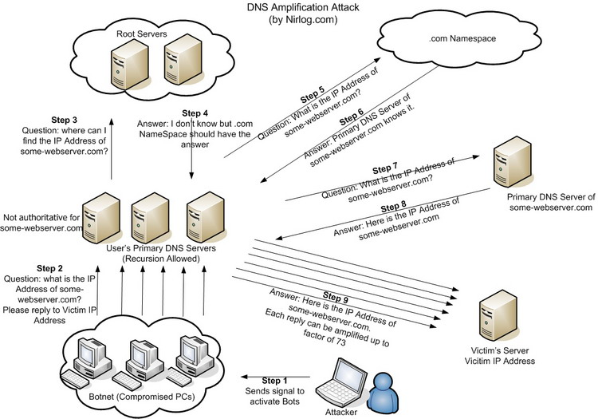
DNS Amplification Attack

Slide 63
DNS Security
DNS Hijack: Cutting the binding between name and IP
DNS DoS (Denial of Service) attack
BAOFENG.com & DNSPod
2009-5-18: DNSPod is attacked and banned
2009-5-19: The Internet in China is almost down
Fixed timer: query for BAOFENG.com once per second!
Solutions
/etc/hosts, dnsmasq, OpenDNS, etc.
DNS shield to defend against DoS attack

Slide 64

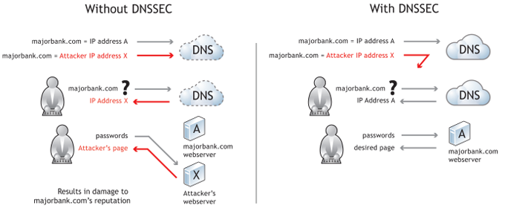
DNSSEC: Protect DNS Record
Only part of the zones are using DNSSEC, e.g., .gov, .org

Slide 65
Problem 4.5
While browsing the Web, you click on a link that identifies an Internet host named www.cslab.scholarly.edu. Your browser asks your Domain Name System (DNS) name server, M, to find an Internet address for this domain name. Under what conditions is each of the following statements true of the name resolution process?

Slide 66
Problem 4.5
To answer your query, M must contact one of the root name servers.
If M answered a query for www.cslab.scholarly.edu in the past, then it can answer your query without asking any other name server.
M must contact one of the name servers for cslab.scholarly.edu to resolve the domain name.
Notes:
Ex. 4.5
A is true only when M’s cache misses and the prefix of the name has nothing in common with the domain that M serves.
B will be true only if the time-to-live of the DNS record cached by M has not expired. If the binding found by M in its cache for www.cslab.scholarly.edu has expired, then M must contact at least one other name server to resolve the domain name.
C is true only if M has no valid information in its cache for www.cslab.scholarly.edu.

Slide 67
Problem 4.5
If M has the current Internet address of a working name server for scholarly.edu cached, then that name server will be able to directly provide an answer.
If M has the current Internet address of a working name server for cslab.scholarly.edu cached, then that name server will be able to directly provide an answer.
Notes:
D is not usually true, because the scholarly.edu name service will normally refer M to the cslab.scholarly.edu name service, rather than answer the query itself. (Though it is possible to configure a name service to directly contain the data for one or more of its subdomains.)
E will normally be true, though it is possible that the name is a synonym that requires cslab.scholarly.edu to ask yet another name server for help.

